Slide 1
Computer Networks
“THE MEDIUM ACCESS CONTROL”
Asst. Lect. Ahmed M. Jasim
Computer Department - College of Engineering
University of Diyala
2017

Slide 2
THE MEDIUM ACCESS CONTROL
Network links can be divided into two categories:
Point-to-Point channels
Broadcast channels
This chapter deals with broadcast links and their protocols.
In the literature, broadcast channels are sometimes referred to as multi-access channels or random access channels.

Slide 3
THE MEDIUM ACCESS CONTROL
In any broadcast network, the key issue is how to determine who gets to use the channel when there is competition for it.
The protocols used to determine who goes next on a multi-access channel belong to a sublayer of the data link layer called the MAC sublayer.
The MAC sublayer is especially important in LANs, particularly wireless ones
WANs, in contrast, use point-to-point links.

Slide 4
THE CHANNEL ALLOCATION PROBLEM
The central theme of this chapter is how to allocate a single broadcast channel among competing users.
The channel might be a portion of the wireless spectrum, or a single wire or optical fiber to which multiple nodes are connected.
The channel connects each user to all other users and any user who makes full use of the channel interferes with other users who also wish to use the channel.

Slide 5
THE CHANNEL ALLOCATION PROBLEM
Static Channel Allocation
Chop up its capacity by using one of the multiplexing schemes, such as FDM (Frequency Division Multiplexing).
If there are N users, the bandwidth is divided into N equal-sized portions.
When there is only a small and constant number of users, each of which has a steady stream or a heavy load of traffic, this division is a simple and efficient allocation mechanism. A wireless example is FM radio stations. .

Slide 6
THE CHANNEL ALLOCATION PROBLEM
However, when the number of senders is large and varying or the traffic is bursty, FDM presents some problems.
Some of users will be denied permission for lack of bandwidth.
When some users are quiescent, their bandwidth is simply lost.
The mean delay for the divided channel is N times worse than if all the frames were somehow magically arranged orderly in a big central queue

Slide 7
THE CHANNEL ALLOCATION PROBLEM
T= The mean time delay
C= Capacity (bps)
λ = Average arrival rate (frames/sec)
1/μ = Average length of frames bits
μC = The service rate (frames/sec)
For example, if C = 100 Mbps, frame length (1/μ) = 10,000 bits, and the frame arrival rate (λ) is 5000 frames/sec, then:

Slide 8
THE CHANNEL ALLOCATION PROBLEM
Now let us divide the single channel into N independent sub-channels, each with capacity C/N bps. The mean input rate on each of the sub-channels will now be λ/N. Recomputing T, we get:
if we were to replace the 100-Mbps network with 10 networks of 10 Mbps each and statically allocate each user to one of them, the mean delay would jump from 200 μsec to 2 msec.

Slide 9
THE CHANNEL ALLOCATION PROBLEM
Assumptions for Dynamic Channel Allocation
1- Independent Traffic
2- Single Channel
3- Observable Collisions
4- Continuous or Slotted Time
5- Carrier Sense or No Carrier Sense

Slide 10
MULTIPLE ACCESS PROTOCOLS
When more than two nodes send at the same time, the transmitted frames collide.
All collide frames are lost and the bandwidth of the broadcast channel will be wasted.
We need multiple access protocols to coordinate access to multipoint or broadcast link.

Slide 11
MULTIPLE ACCESS PROTOCOLS
Aloha Protocols
History
The Aloha protocol was designed as part of a project at the University of Hawaii.
Communications was typically between remote stations and a central sited named Menehune or vice versa.
All message to the Menehune were sent using the same frequency.
When it received a message intact, the Menehune would broadcast an ack on a distinct outgoing frequency.
The outgoing frequency was also used for messages from the central site to remote computers.
All stations listened for message on this second frequency.

Slide 12
MULTIPLE ACCESS PROTOCOLS
A- Pure Aloha
Pure Aloha is an unslotted, fully-decentralized protocol.
It is extremely simple and trivial to implement. The ground rule is - "when you want to talk, just talk!".
So, a node which wants to transmits, will go ahead and send the packet on its broadcast channel, with no consideration whatsoever as to anybody else is transmitting or not.

Slide 13
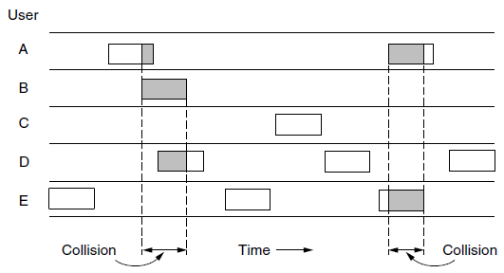
MULTIPLE ACCESS PROTOCOLS

Slide 14
MULTIPLE ACCESS PROTOCOLS
B- Slotted Aloha
All frames consist of exactly L bits.
Time is divided into slots (a slot equals the time to transmit one frame).
Nodes start to transmit frames only at the beginnings of slots.
The nodes are synchronized so that each node knows when the slots begin.
If two or more frames collide in a slot, then all the nodes detect the collision event before the slot ends.

Slide 15
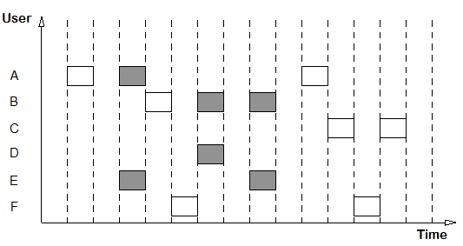
MULTIPLE ACCESS PROTOCOLS

Slide 16
MULTIPLE ACCESS PROTOCOLS
Carrier Sense Multiple Access Protocols
In both slotted and pure ALOHA, a node's decision to transmit is made independently of the activity of the other nodes attached to the broadcast channel.
As humans, we have human protocols that allows us to not only behave with more civility, but also to decrease the amount of time spent "colliding" with each other in conversation and consequently increasing the amount of data we exchange in our conversations.

Slide 17
MULTIPLE ACCESS PROTOCOLS
Specifically, there are two important rules for polite human conversation
a- Listen before speaking: If someone else is speaking, wait until they are done.
In the networking world, this is termed carrier sensing.
b- If someone else begins talking at the same time, stop talking.
In the networking world, this is termed collision detection.

Slide 18
MULTIPLE ACCESS PROTOCOLS
CSMA protocols listen for a carrier, therefore they are called carrier sense protocols.
CSMA protocols can reduce the possibility of collision, but it can't eliminate it because of the propagation delay (The time it takes for a signal to propagate from one of the channel to another).
A station may sense the medium and find it idle, only because the first bit of a frame sent by another station has not been received.

Slide 19
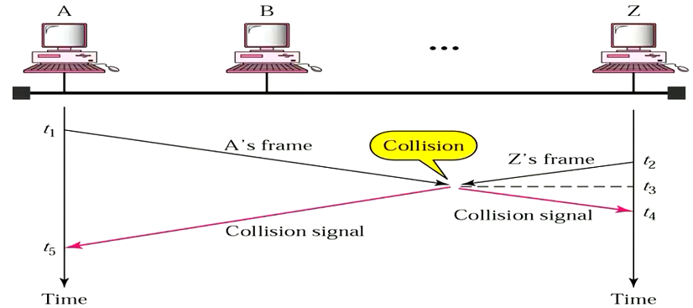
MULTIPLE ACCESS PROTOCOLS

Slide 20
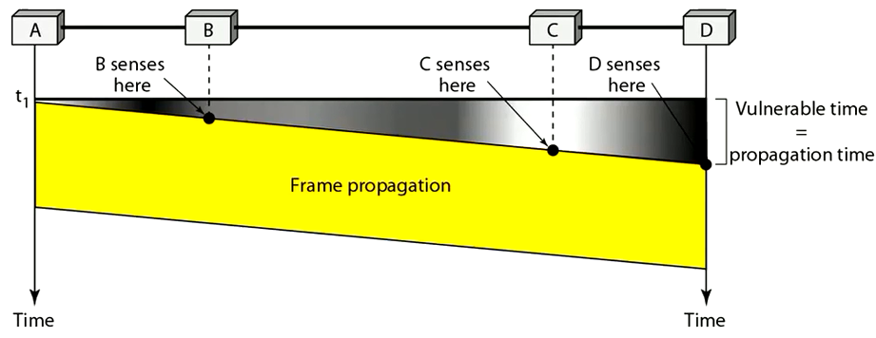
MULTIPLE ACCESS PROTOCOLS
The longer this propagation delay, the larger the chance that a carrier-sensing node is not yet able to sense a transmission that has already begun at another node in the network.
Vulnerable time: time in which there is possibility of collision.
Vulnerable time for CSMA = Maximum propagation time (Tp)

Slide 21
MULTIPLE ACCESS PROTOCOLS
Persistent and Nonpersistent CSMA
A- 1- persistent CSMA
When the sender is ready to transmit data, it checks if the medium is busy.
If busy, it senses the medium continually until it becomes idle.
If channel is idle, sends the frame immediately (with probability of 1)
Chance of collision is high.

Slide 22
MULTIPLE ACCESS PROTOCOLS
B- Non-persistent CSMA
If a station has a frame to send, it senses the channel.
If channel is idle, the station sends the frame immediately.
If channel is busy, the station waits a random period of time and then senses the channel again.
Chance of collision is reduced.
Reduce the efficiency of the network because the medium remains idle when there may be stations with frames to send.

Slide 23
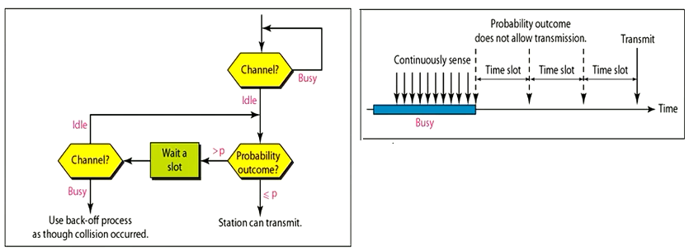
MULTIPLE ACCESS PROTOCOLS
C- p-persistent CSMA
It used if the channel has time slots with a slot duration equal to or greater than the maximum propagation time.
When the sender is ready to transmit data, it checks if the medium is busy.
If busy, it senses the medium continually until it becomes idle.
If channel is idle, it may or may not send (it sends probability of p).
With a probability q = 1 − p, it defers until the next slot. If that slot is also idle, it either transmits or defers again, with probabilities p and q.
This process is repeated until either the frame has been transmitted or another station has begun transmitting.

Slide 24
MULTIPLE ACCESS PROTOCOLS
In the latter case, the unlucky station acts as if there had been a collision (i.e., it waits a random time and starts again). If the station initially senses that the channel is busy, it waits until the next slot and applies the above algorithm.
Reduce the chance of collision.
Improve the efficiency by combining the other two methods.
IEEE 802.11 uses a refinement of p-persistent CSMA that we will discuss later

Slide 25
MULTIPLE ACCESS PROTOCOLS
CSMA with Collision Detection (CMSA/CD)
The CSMA method does not specify the procedure following collision.
CSMA/CD augments the algorithm to handle the collision.
In this method, a station monitors the medium after it sends a frame to see if the transmission was successful. If so, the station is finished. If, however, there is a collision, the frame is sent again.

Slide 26
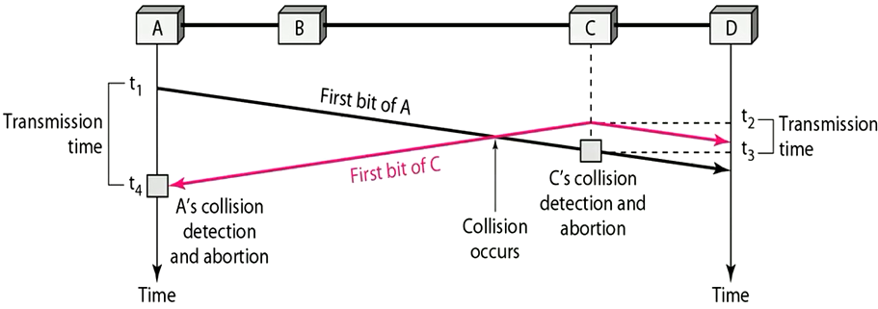
MULTIPLE ACCESS PROTOCOLS

Slide 27
MULTIPLE ACCESS PROTOCOLS
Looking at the figure, we see that:
A transmits for the duration t4-t1
C transmits for the duration t3-t2
For the protocol to work, the length of any frame divided by the bit rate in this protocol must be more than either of these durations.
At time t4, the transmission of A's frame, though incomplete, is aborted
at time t3, the transmission of B's frame, though incomplete, is aborted

Slide 28
MULTIPLE ACCESS PROTOCOLS
Minimum Frame Size
Before sending the last bit of the frame, the sending station must detect a collision, if any, and abort the transmission.
The frame transmission time Tfr must be at least two times the maximum propagation time Tp.
To understand the reason, let us think about the worst-case scenario. If the two station involved in a collision are maximum distance apart:
The signal from the first takes time Tp to reach the second
The effect of the collision takes another time Tp to reach the first.
So the requirement is that the first station must still be transmitting after 2Tp

Slide 29
MULTIPLE ACCESS PROTOCOLS

Slide 30
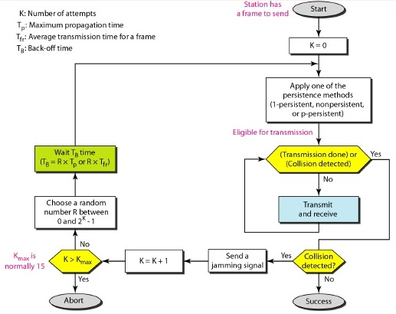
MULTIPLE ACCESS PROTOCOLS
Procedure
.

Slide 31
MULTIPLE ACCESS PROTOCOLS
Energy Level
We can say that the level of energy in a channel can have three values: zero, normal, and abnormal.
At the zero level, the channel is idle.
At the normal level, a station has successfully captured the channel and is sending its frame.
At the abnormal level, there is a collision and the level of the energy is twice the normal level.
A station that has a frame to send or is sending a frame needs to monitor the energy level to determine if the channel is idle, busy, or in collision mode. The following figure shows the situation.

Slide 32
MULTIPLE ACCESS PROTOCOLS

Slide 33
THANK YOU

